Slide 1
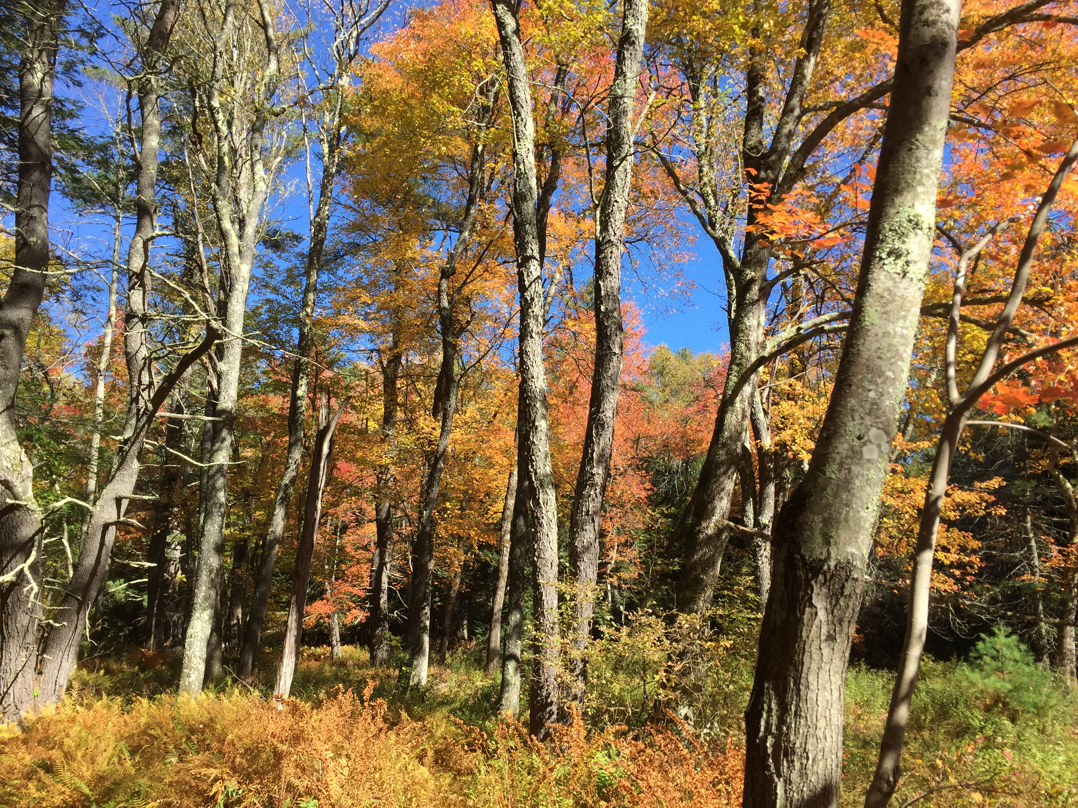


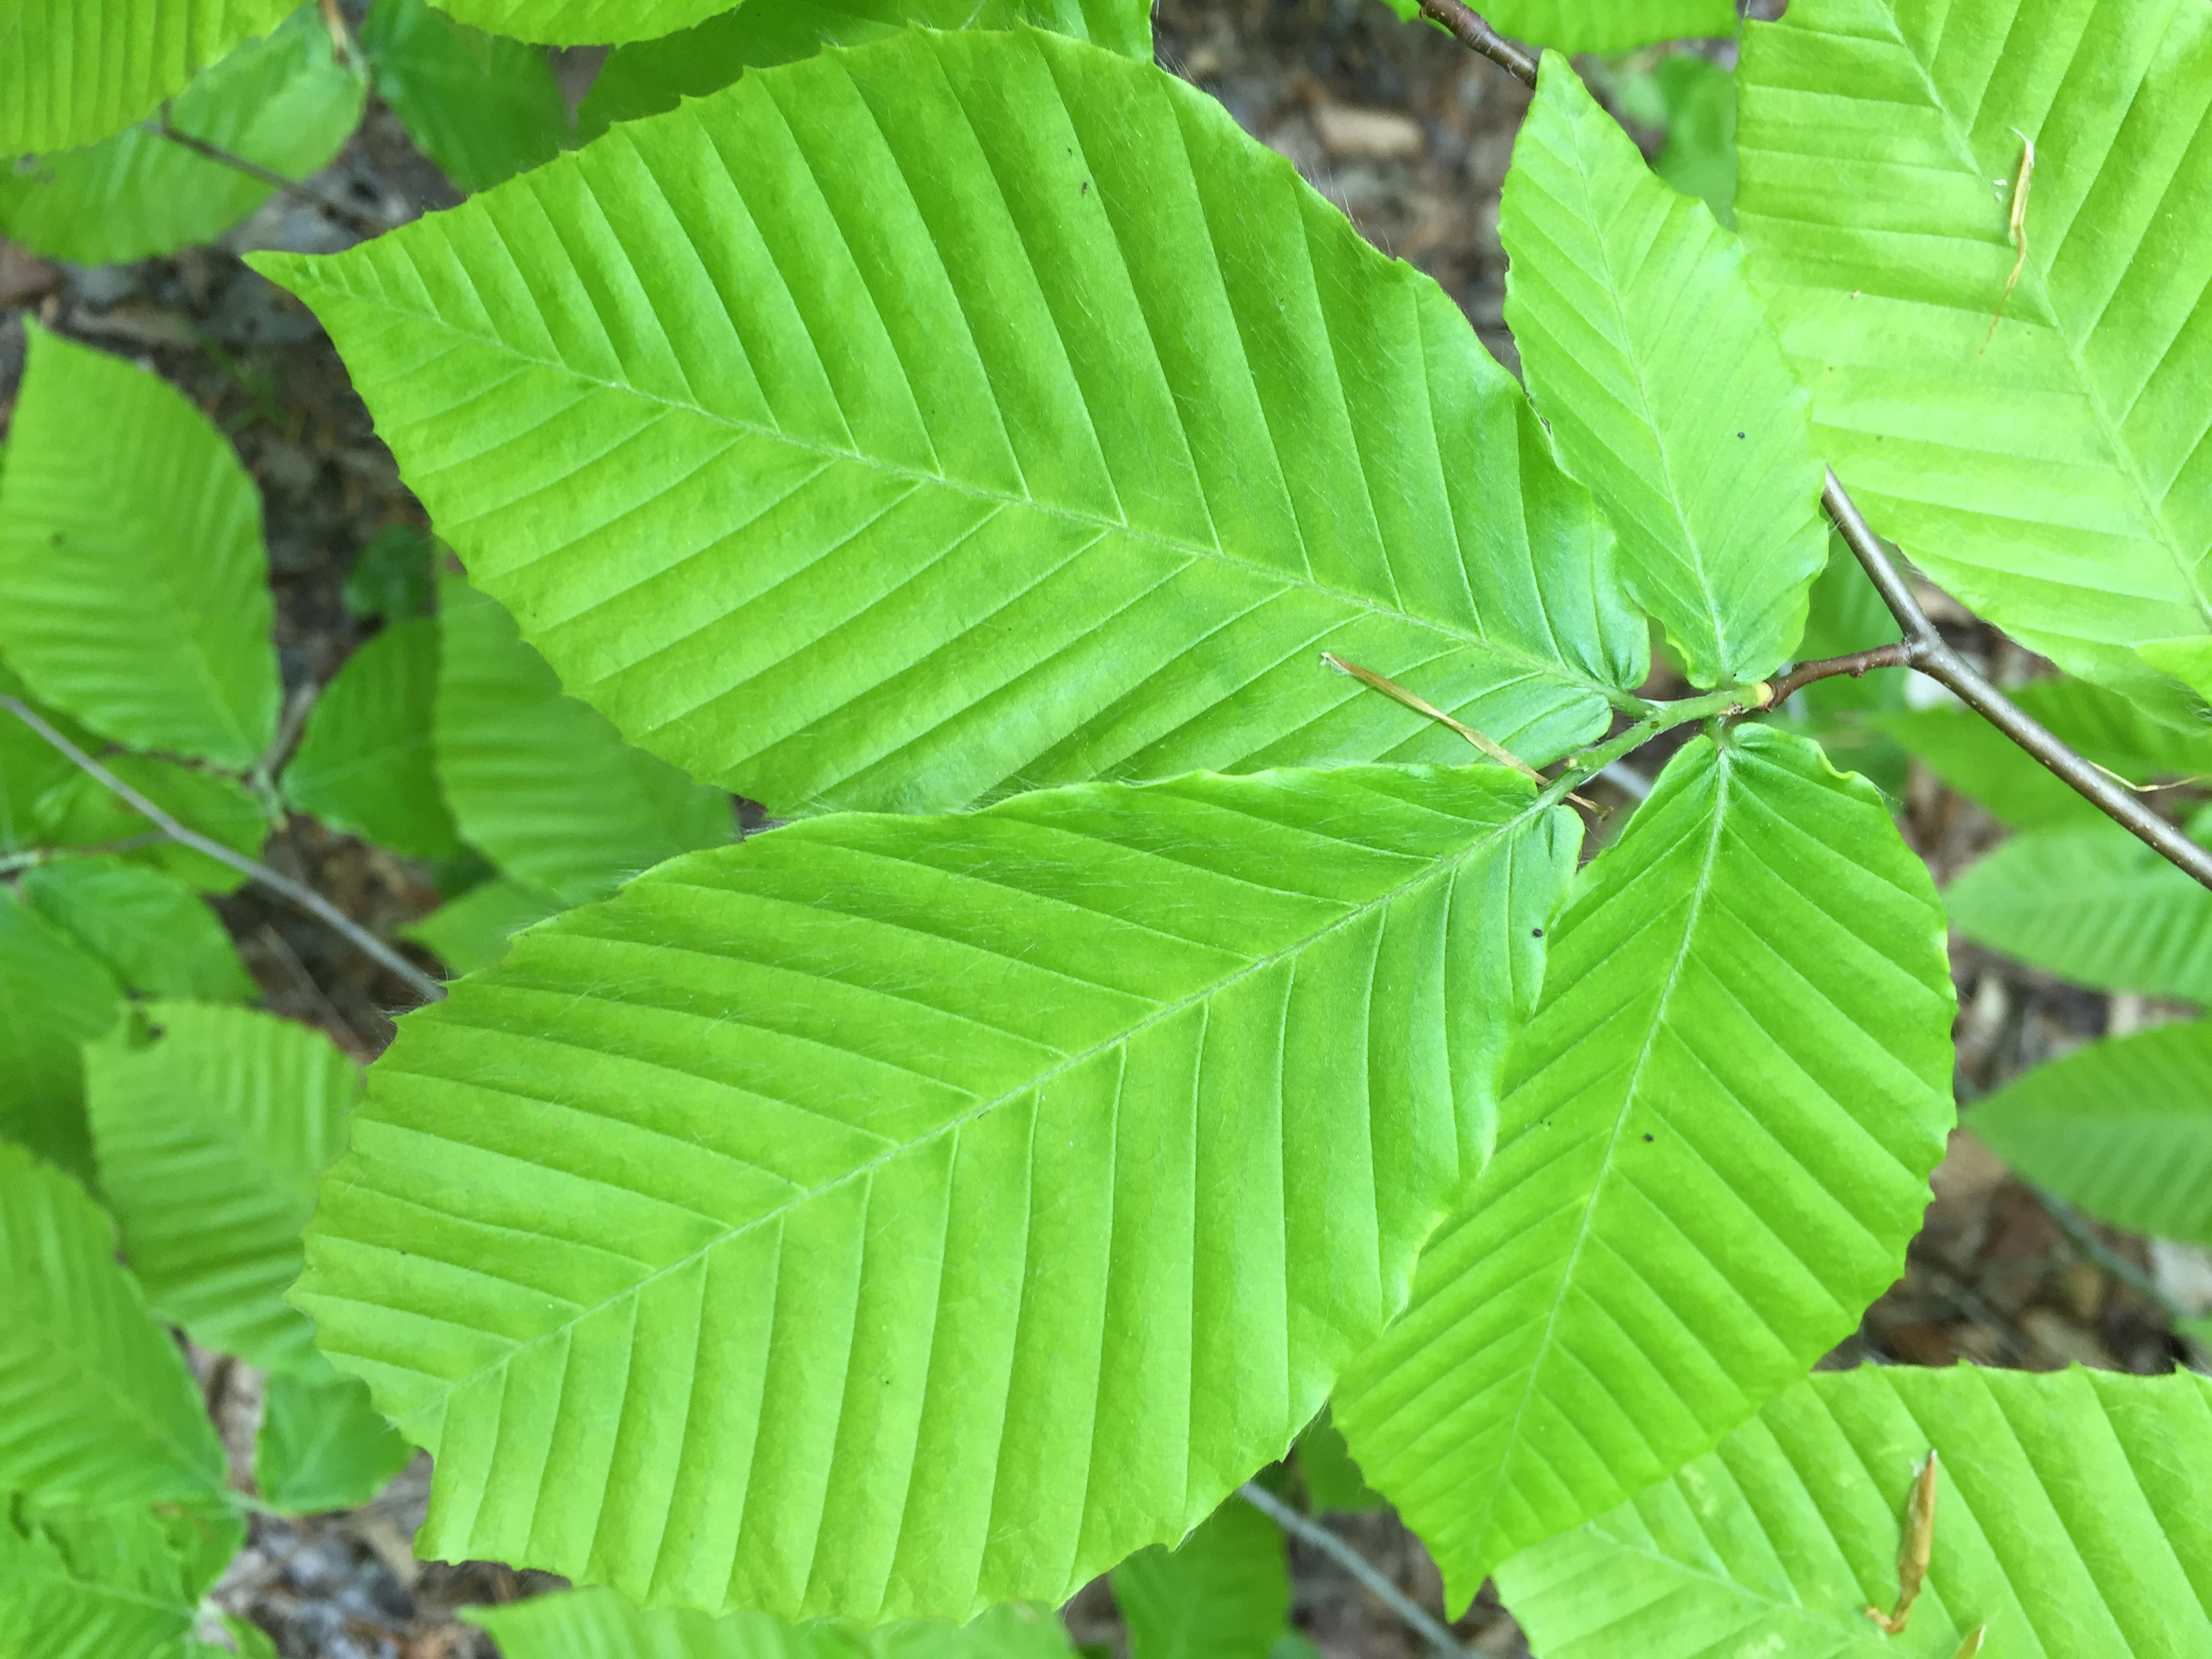
Rethinking False Spring
Catherine Chamberlain
Arnold Arboretum | Harvard University

Slide 2
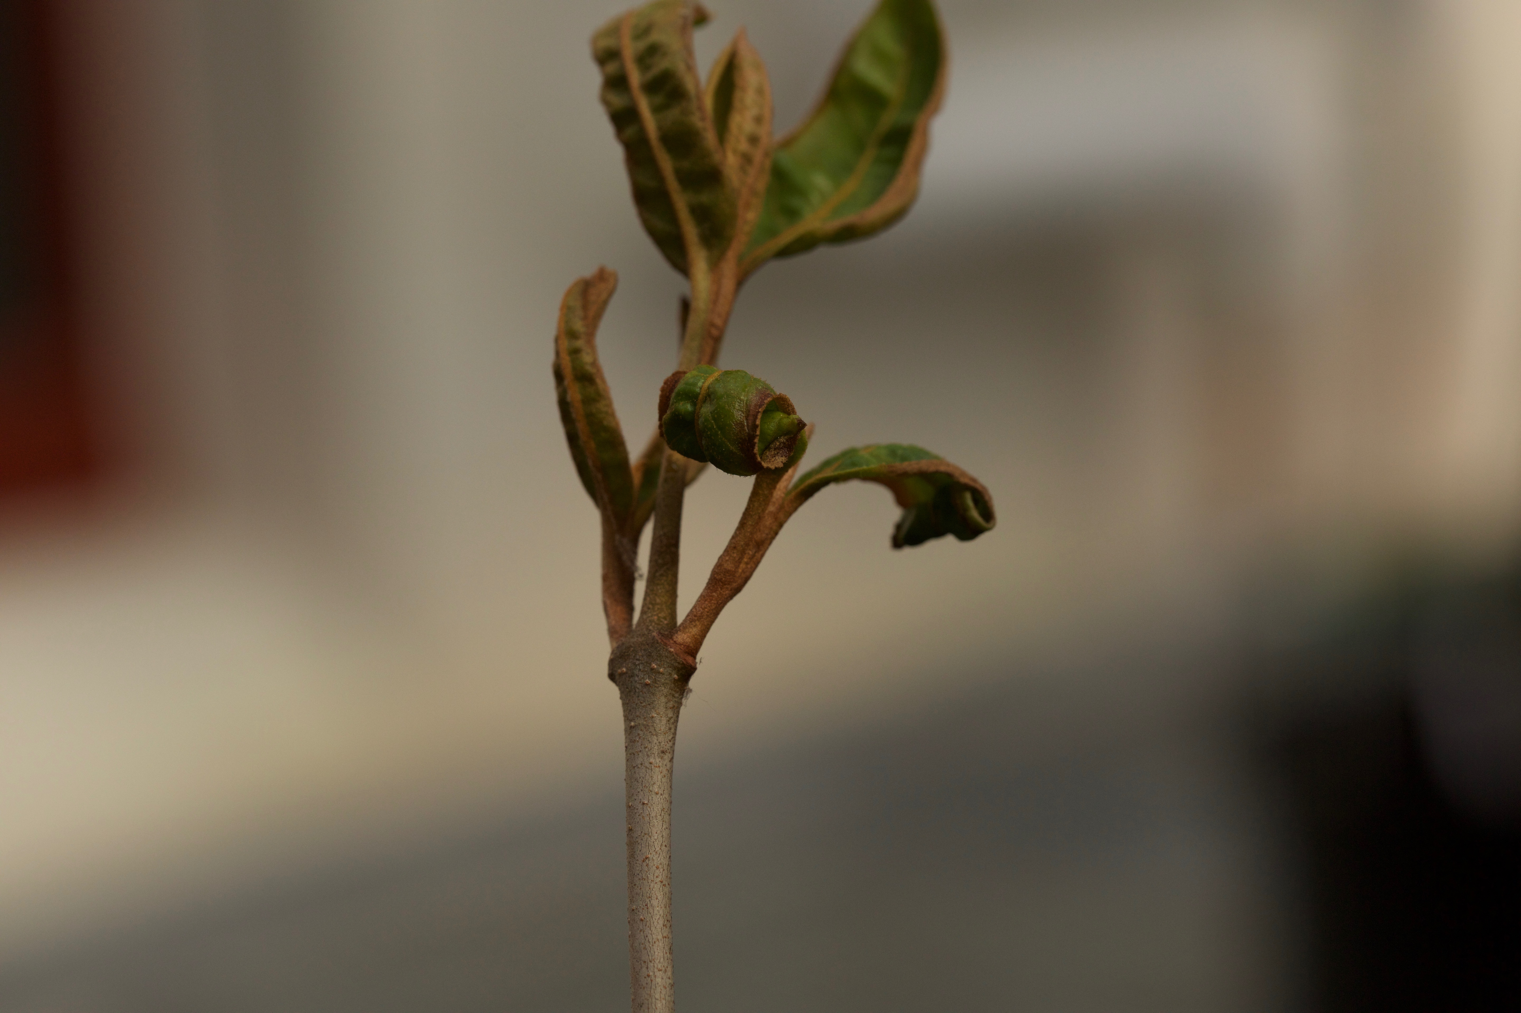
OUTLINE
Quick Review of False Spring
Talk about Buds Experiment: Initial Results
Field Freezing Experiment
Regional Risk: Maps and Ideas
Questions

Slide 3
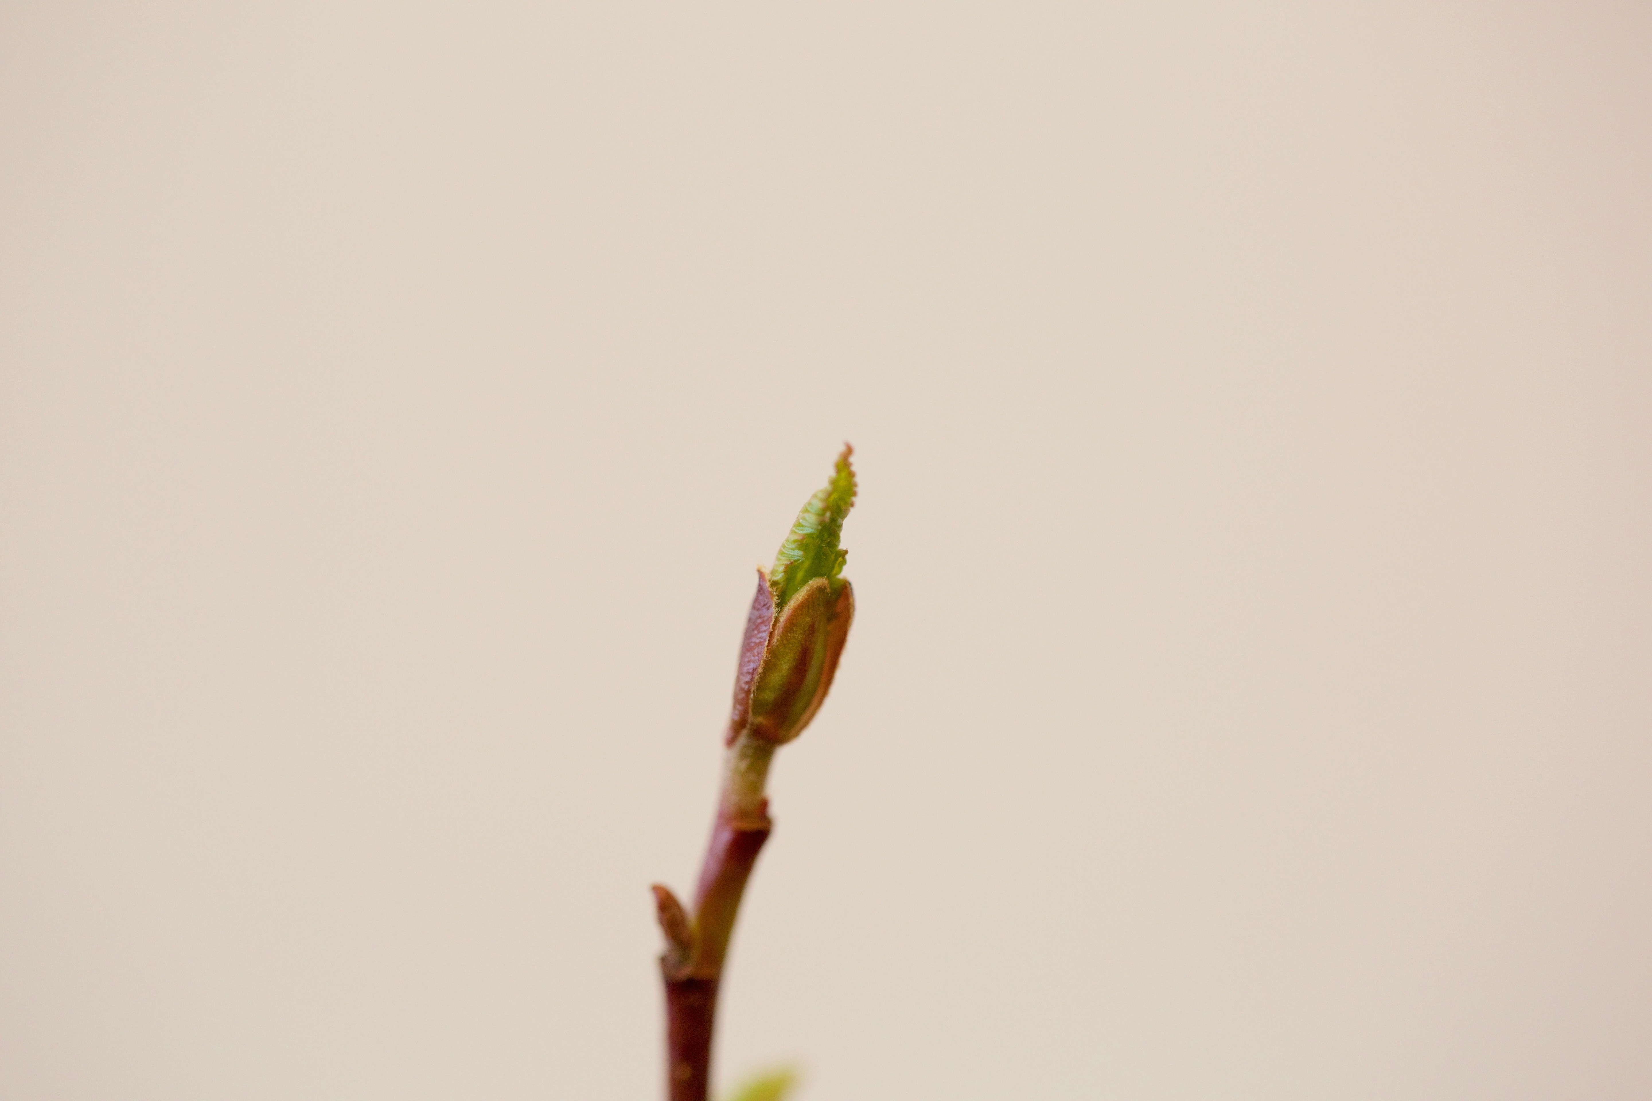
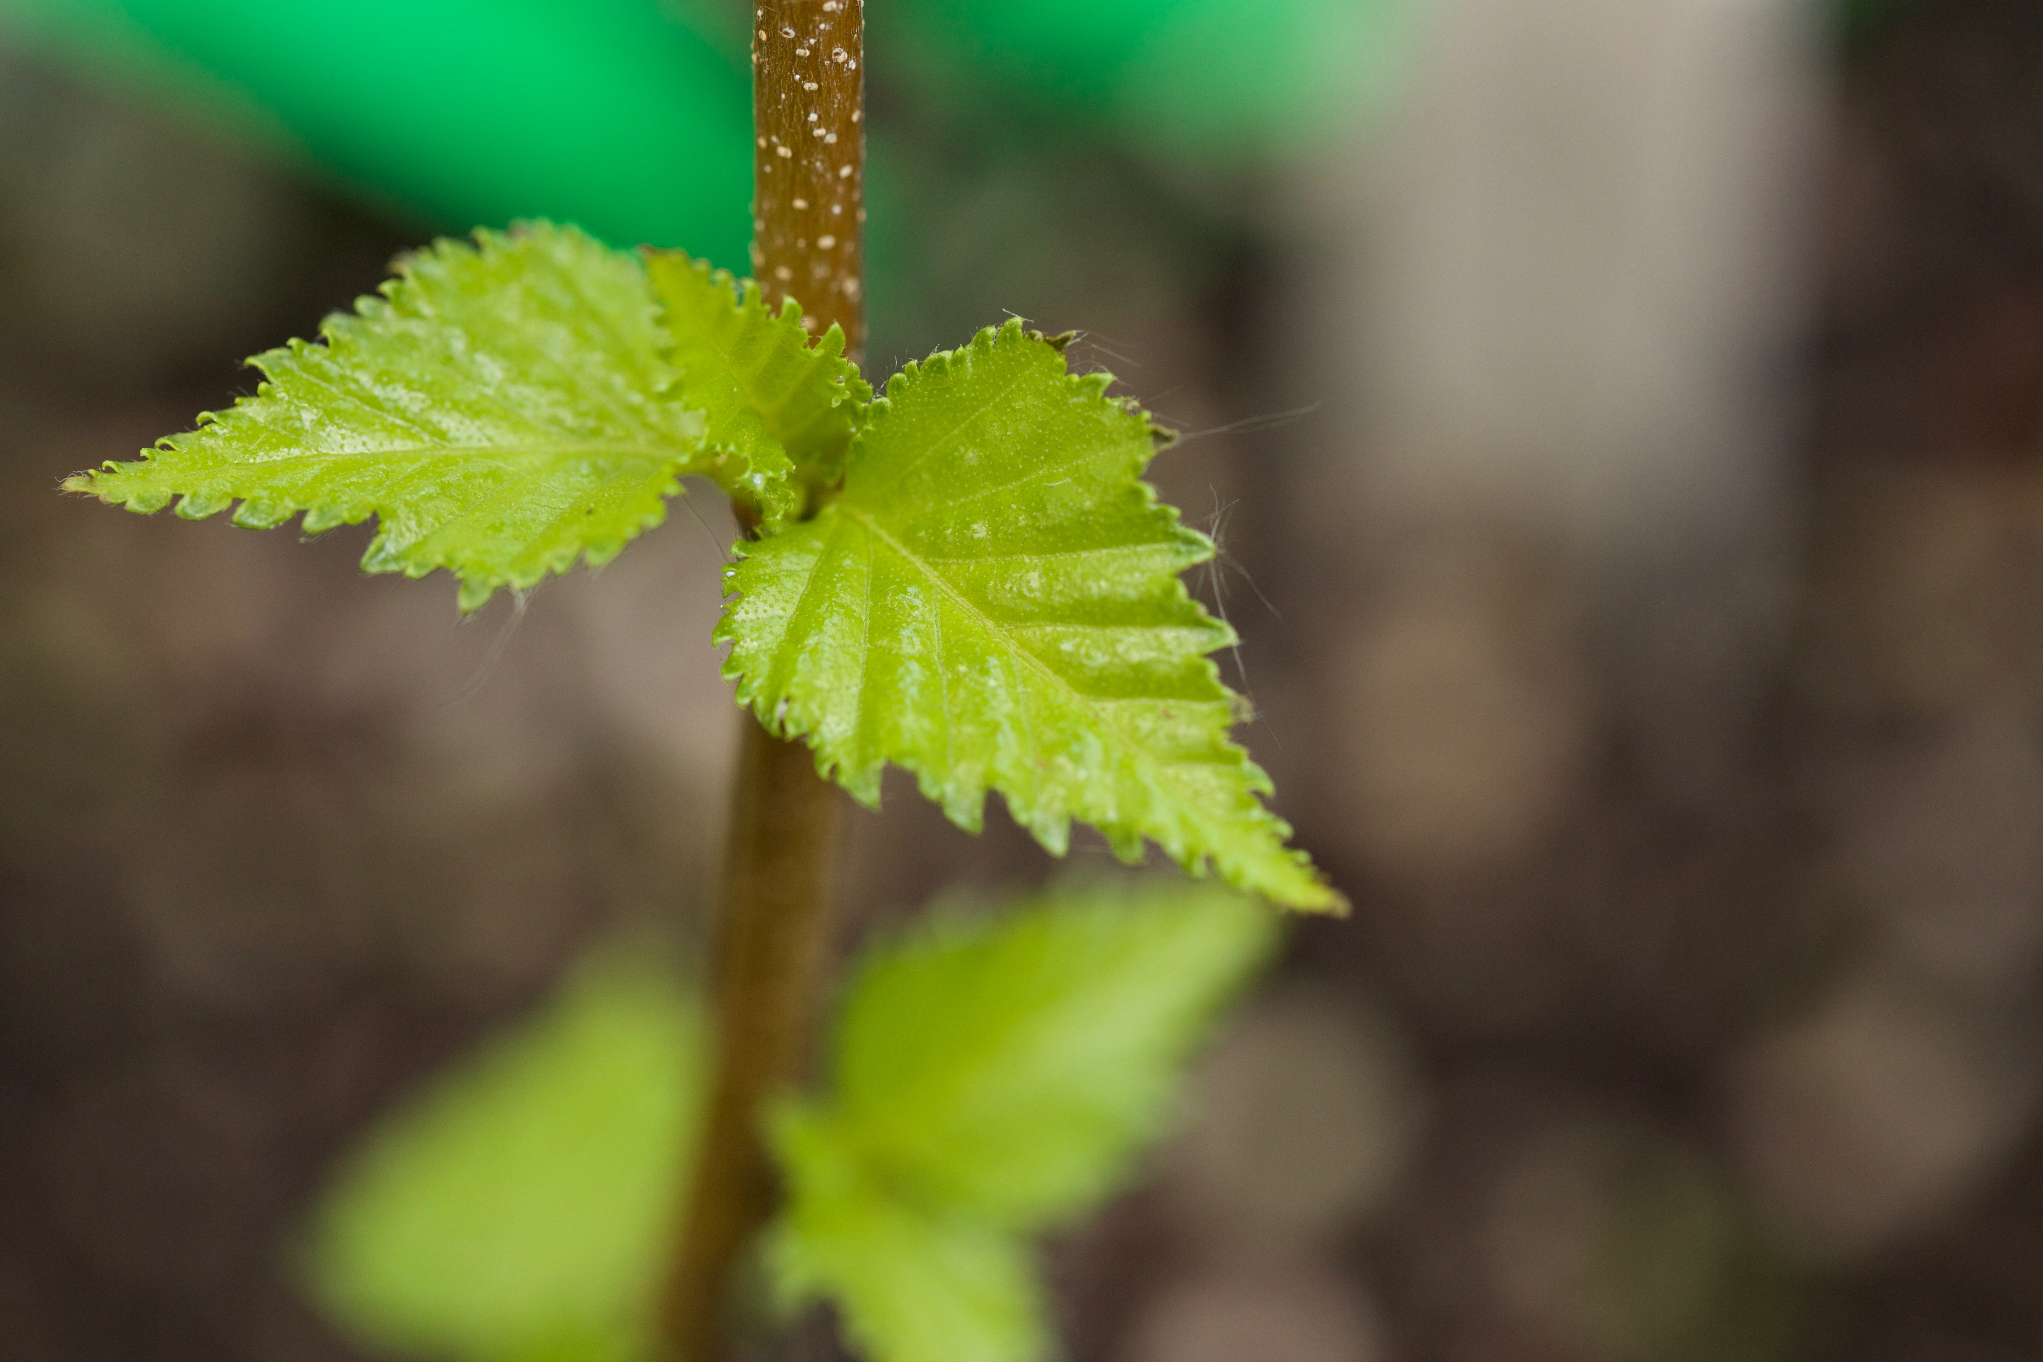
Alnus incana - budburst
False Spring Risk
Interested in time between leaf budburst and leafout,
when frost tolerance is lowest but risk is still relatively high.
BUDBURST
LEAFOUT
DURATION OF VEGETATIVE RISK
Betula populifolia - leafout

Slide 4
Calendar
OCT
NOV
DEC
JAN
FEB
MAR
APR
MAY
JUNE
Chilling
Warming
Photoperiod
INPUTS
Endodormancy
Ecodormancy
Duration of Vegetative Risk
OUTPUTS
Budburst
Leafout
Likelihood
Potential
Risk
False Spring
Intensity

Slide 5
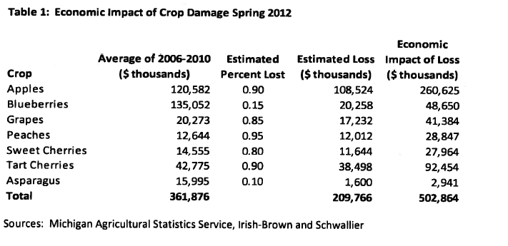
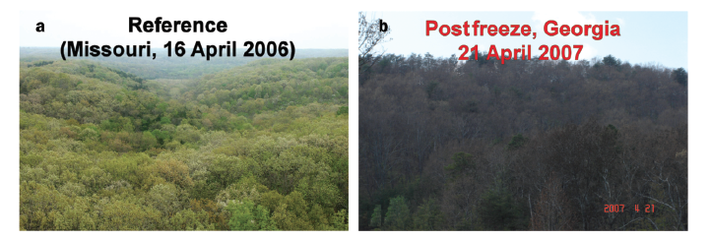
MASSIVE ECONOMIC AND ECOLOGICAL CONSEQUENCES.
Knudson, 2012
Gu et al, 2008

Slide 6
STRATEGIES:
Avoidance
Tolerance

Slide 7
STRATEGIES:
Avoidance
Tolerance
DVR
DVR

Slide 8
STRATEGIES:
Avoidance
Tolerance
DVR
Trichomes on young leaves
Serrations along leave margins
DVR

Slide 9
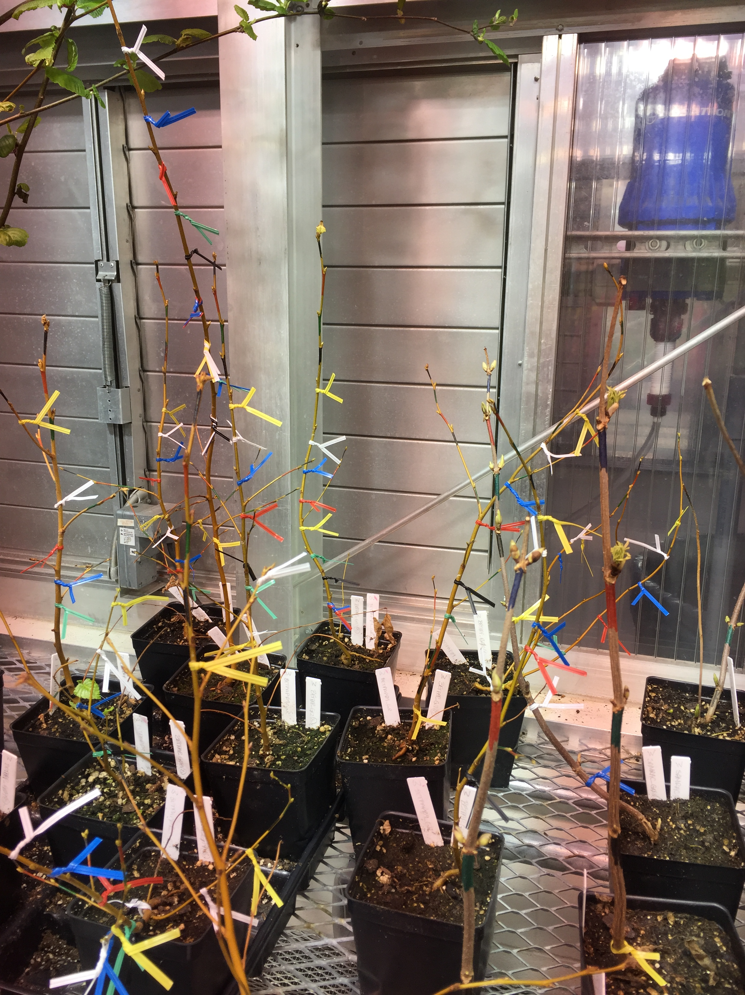
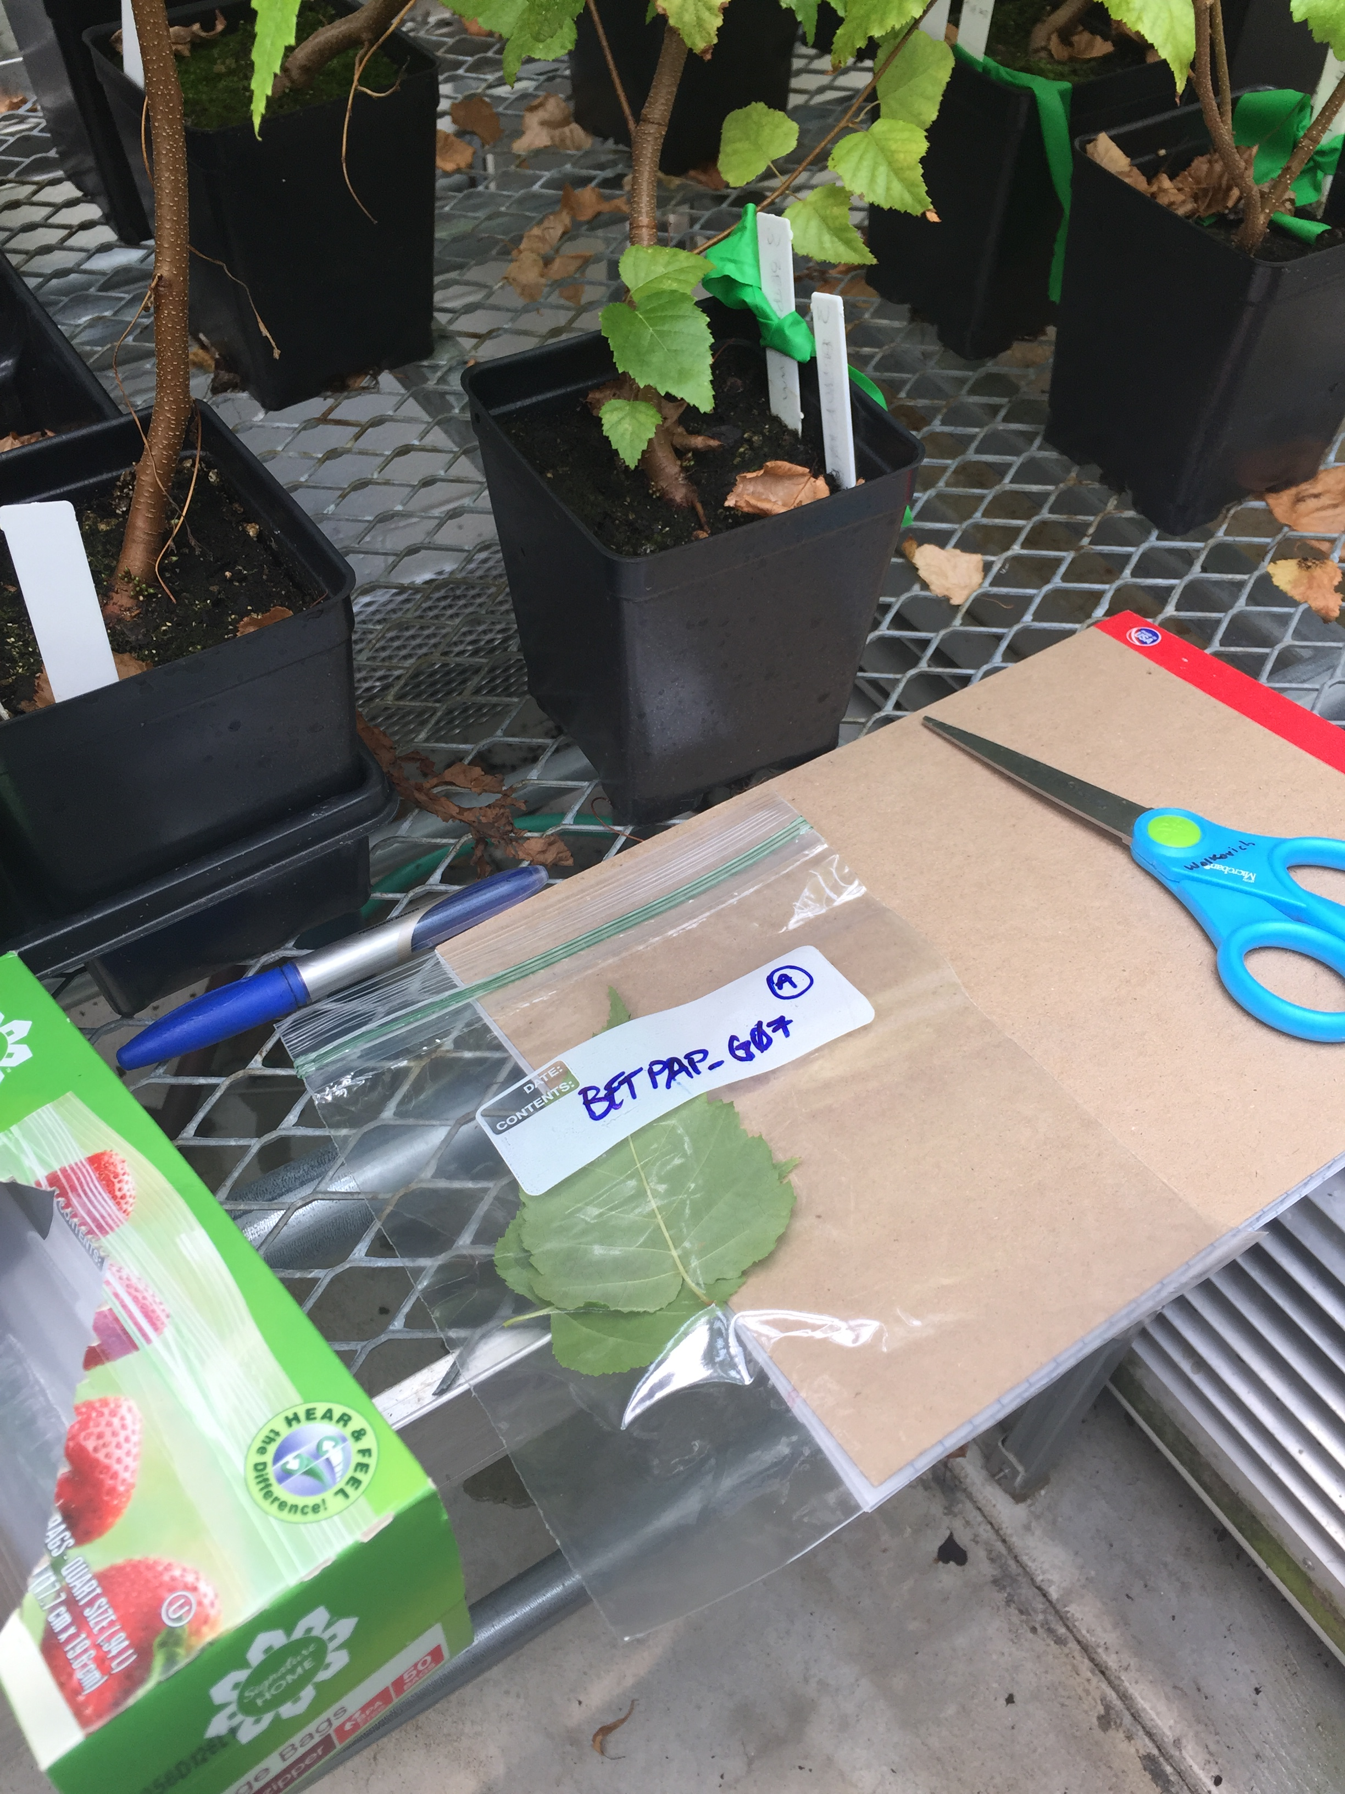
Buds Experiment
Freezing Experiment with Greenhouse individuals

Slide 10
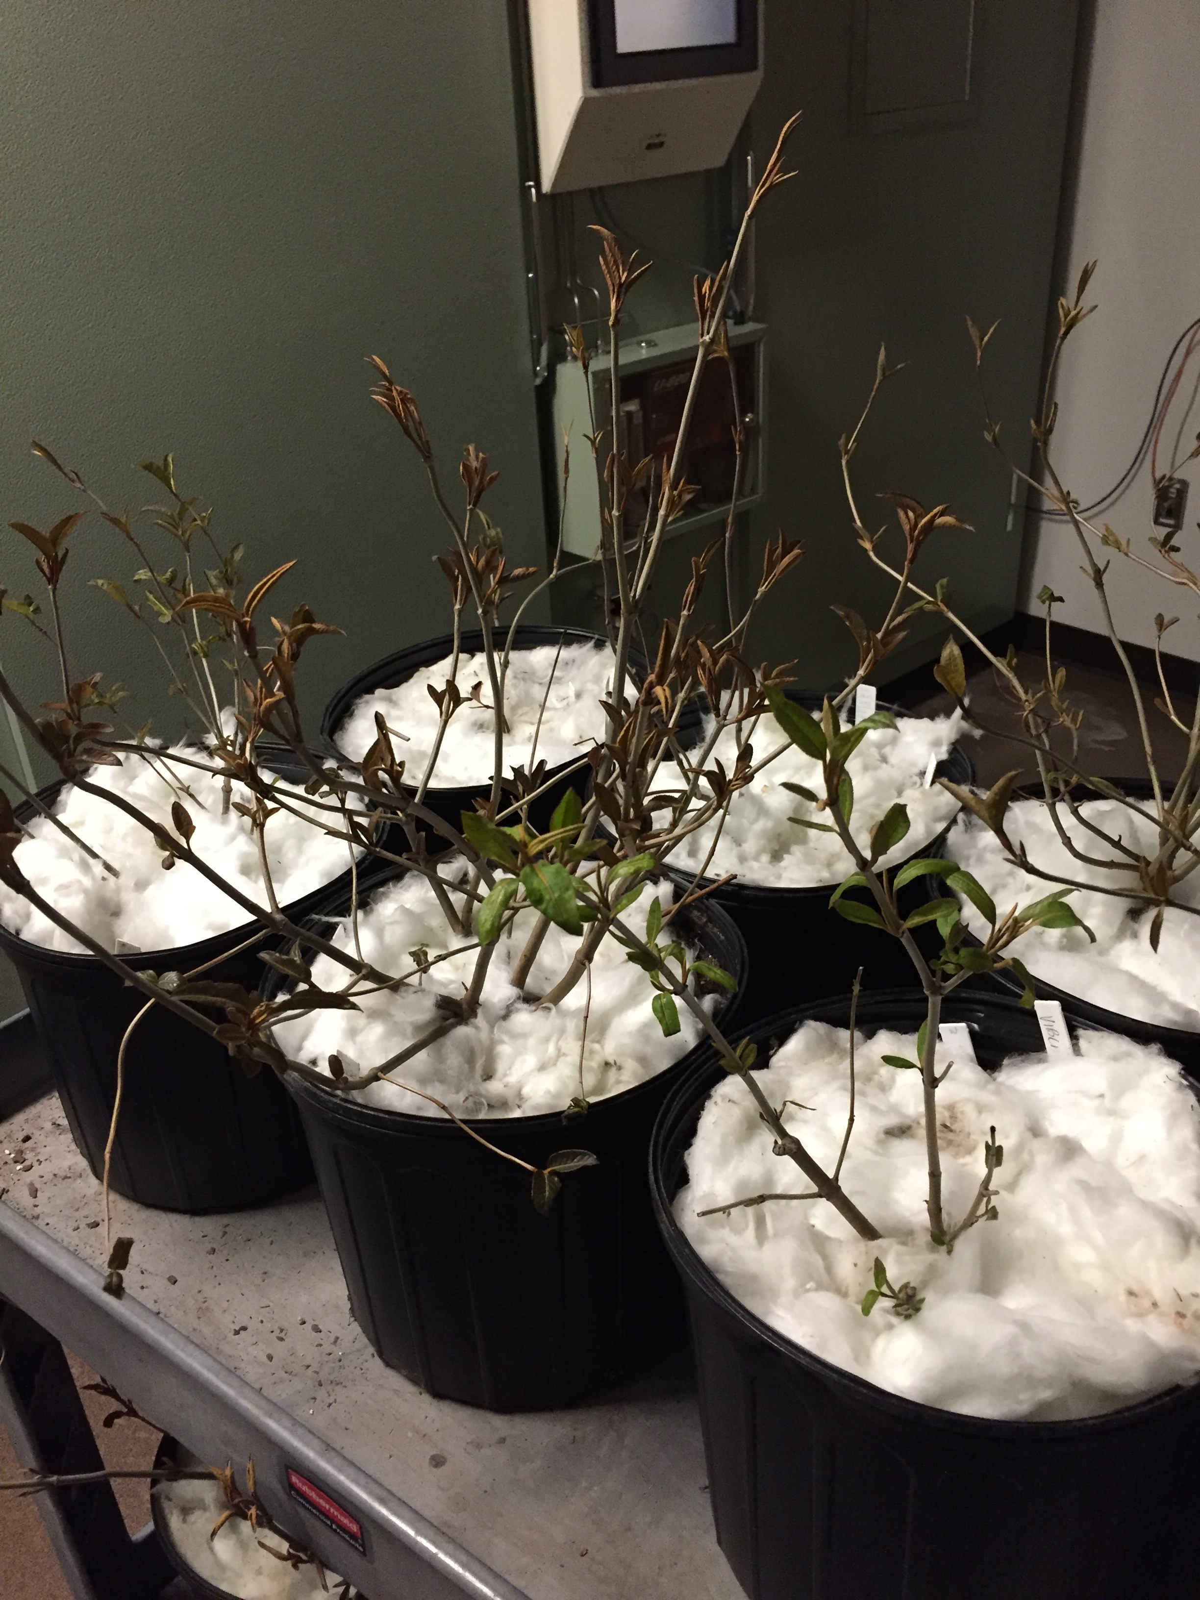
EXPERIMENT LAYOUT
SPECIES:
ACESAC
ACEPEN (?)
QUEALB
QUERUB
POPGRA
ILEVER
LONCAN
ALNINC
BETALL
FAGGRA (?)

Slide 12
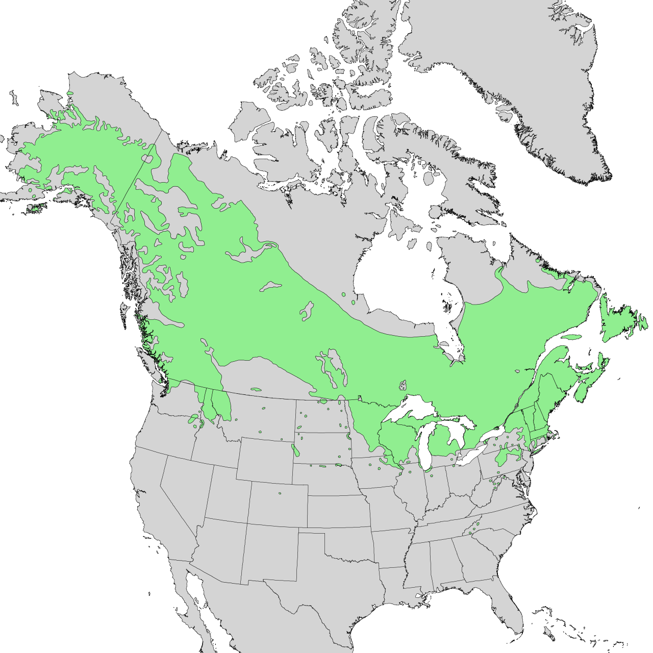
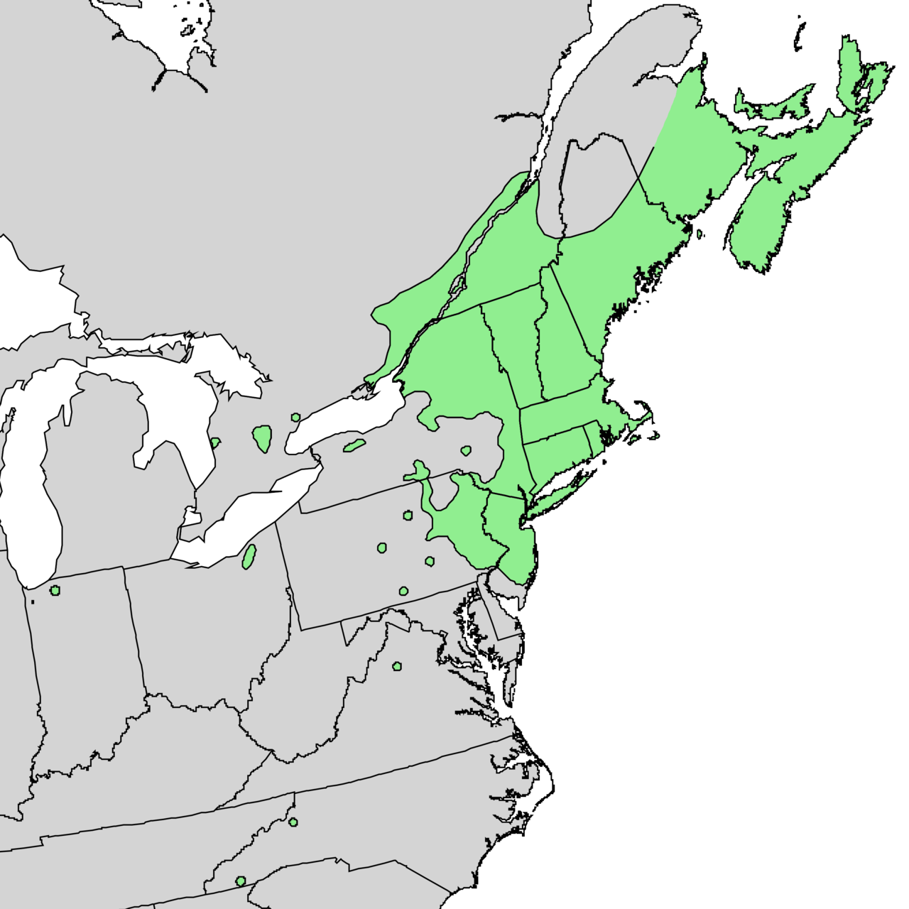
BETPAP
BETPOP
BETPAP
BETPOP

Slide 13
Species: 2-3 -- BETPAP, BETPOP, SAMRAC (?)
Individuals: 14-18
Buds: 6-36
TX: Control vs. Freeze
dvr ~ tx + species + (1|individual)
DVR: Duration of Vegetative Risk

Slide 14
Percent Budburst Model: percBB ~ tx + species

Slide 15
BETPAP = Sp 1
BETPOP = Sp 2
dvr ~ tx + species + (1|individual)

Slide 16
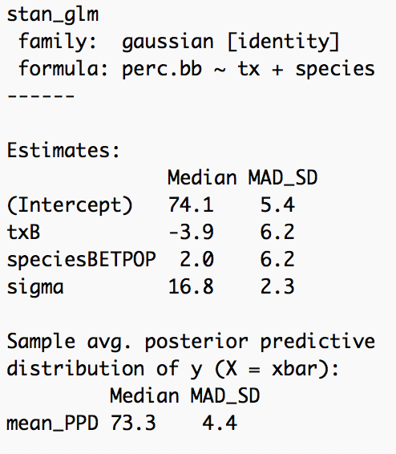
Dove straight into the Real data...
** Need to make fake data and start learning about Beta Distribution models
** Not including Sambucus racemosa

Slide 17
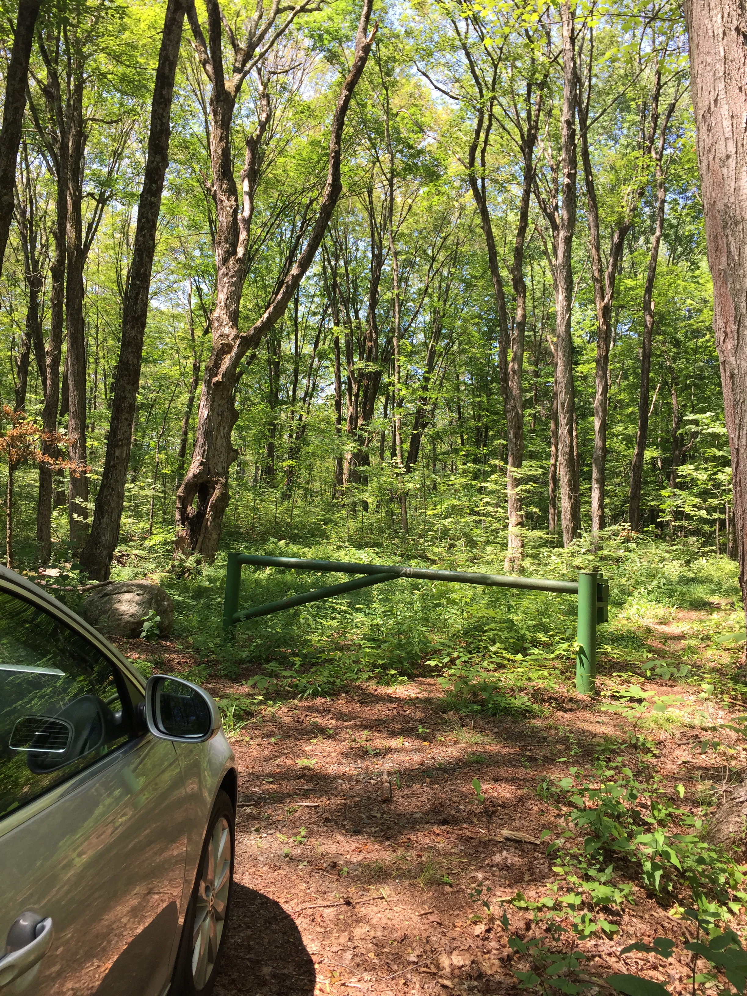
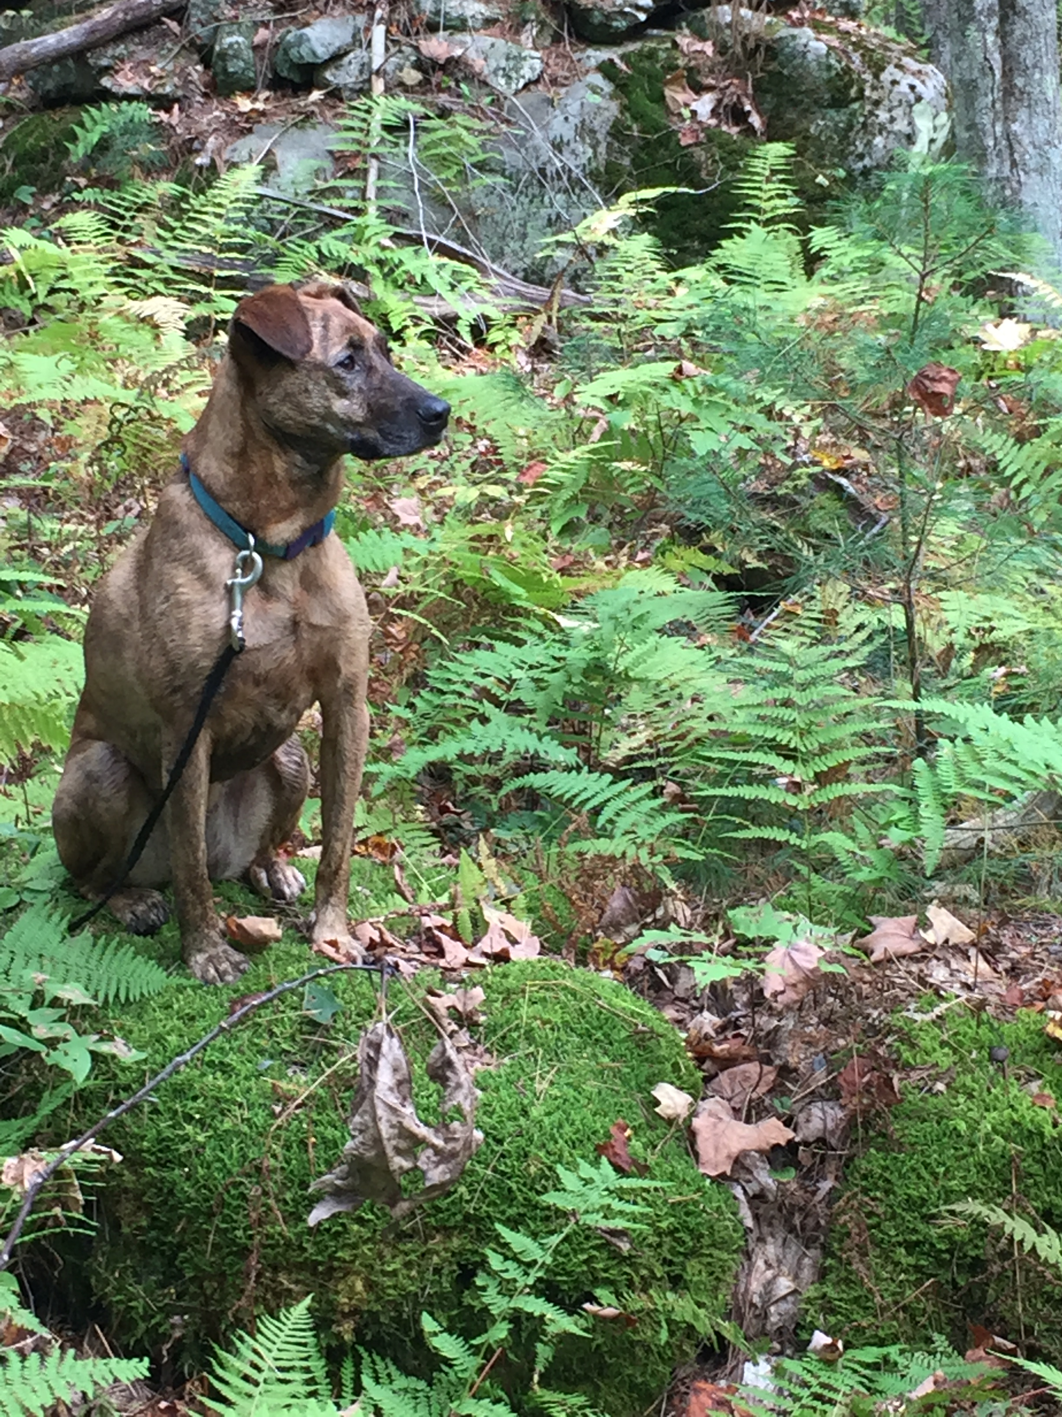
FIELD FREEZING EXPERIMENT
ACEPEN
ACESAC
BETLEN
CAROVA
CORCOR
FAGGRA (?)
HAMVIR
ILEVER
VIBACE
24 saplings per species
16 adults per species

Slide 18
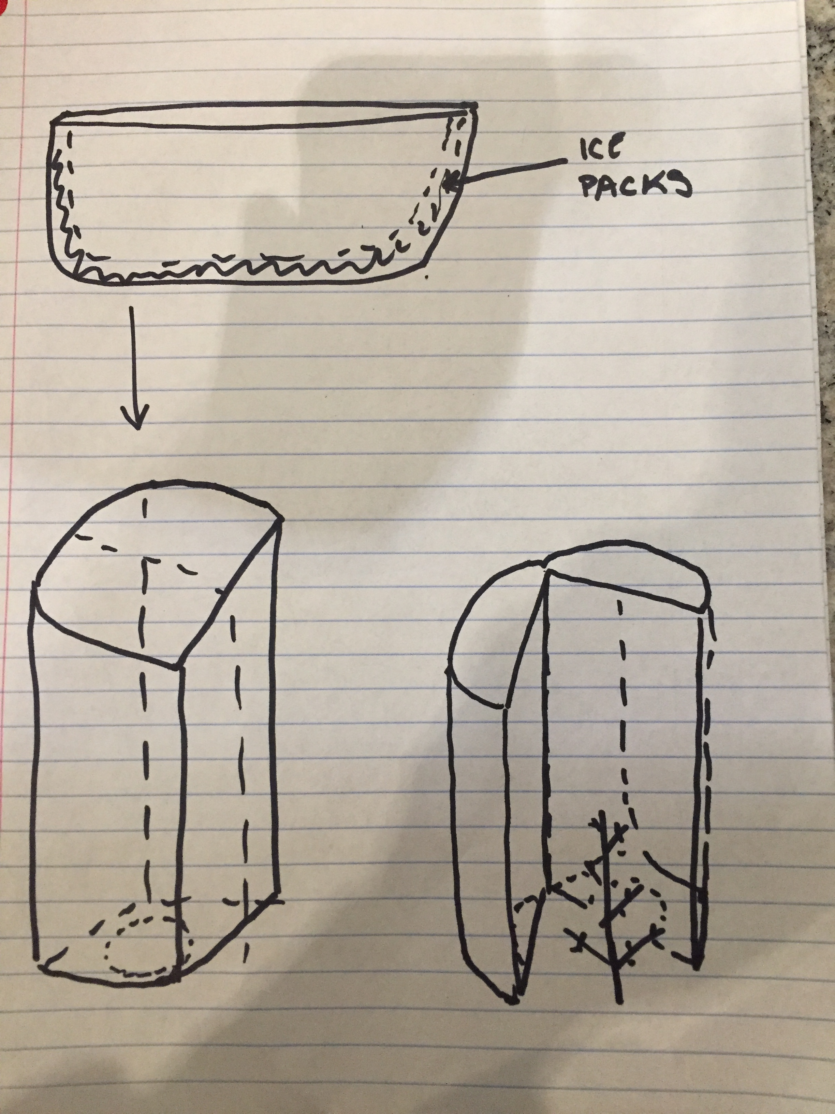

Slide 19
REGIONAL RISK
Investigating the frequency of false spring events from
1950 – 2016.
ACEPSU
ALNGLU
AESHIP
BETPEN
FAGSYL
FRAEXC
TILCOR
TILPLA
QUEROB
PEP725: phenology data
E-OBS: gridded climate data

Slide 23
Comparison of the two...

Slide 24
NEXT STEPS...
Finish Rethinking Manuscript
Finalize Buds Model and prepare seeds
Finish Building the Field Freezer and begin testing
Finish determining number of false spring events per decade for each species
Prepare data for Stan model
Make more maps with PEP725 data

